Slide 1
HP Converged Systems RA for Red Hat Enterprise Virtualization on CS700x
Fast track your path to open source virtualization
© Copyright 2013 Hewlett-Packard Development Company, L.P. The information contained herein is subject to change without notice. HP Restricted. For HP and SI/O Partner use only.
Notes:
Thanks for joining me for the discussion today about HP Converged Systems RA for Red Hat Enterprise Virtualization on HP CS700x.
HP and Red Hat are delivering new capabilities for customers to more simply, efficiently, and reliably transform their IT environments, on their terms, to take advantage of the agility provided by virtualization and cloud computing technologies. As part of the HP Converged Infrastructure strategy and supported by our position as leaders in our respective markets, HP has been delivering Red Hat solutions to satisfied customers of all sizes around the world for over a decade.
Our latest wave of innovation is demonstrated with the new HP Converged Systems RA for Red Hat, a Converged System that provides our customers a choice of flexible configurations that meet today’s infrastructure virtualization requirements together with a system that grows as they grow to protect their investment into the future.

Slide 2


Partner with industry leaders
14+ years
of partnership
Notes:
Open source. Open standards. Open future. That's the HP-Red Hat combination. HP has been delivering Red Hat solutions to satisfied customers of all sizes around the world for over a decade. HP and Red Hat lead the way in providing open solutions that help you cut costs, reduce complexity, and increase performance for physical, virtual and cloud environments.
HP delivers comprehensive open computing solutions based on industry-leading HP ProLiant servers and community-powered innovation from Red Hat, the world's leading provider of Linux and open source technology.
The comprehensive HP and Red Hat experience includes certification on a wider range of hardware platforms than other vendors, a single point of purchase, support and implementation services, and a commitment to cost optimization and innovation through open-industry technologies.

Slide 3
Why Red Hat Enterprise Virtualization
Up to 95% to 140% performance gains for real-world enterprise workloads like SAP, Oracle, and Microsoft Exchange¹
Consolidation ratios of 550+ VMs with enterprise workloads running on a single server²
Support for up to 160 logical CPUs and up to 2TB of memory per virtual machine
Red Hat® believes open source simply creates better software. Everyone collaborates. The best technology wins. Not just within one company, but for everyone, anyone, around the world.
¹ Comparison based on benchmark addressing performance evaluation of datacenter servers used in virtualized server consolidation at spec.org as of May 2013. SPEC® and the benchmark name SPECvirt® are registered trademarks of the Standard Performance Evaluation Corporation.
² Red Hat Enterprise Virtualization performance: SPECvirt benchmark
Notes:
1 - Comparison based on benchmark addressing performance evaluation of datacenter servers used in virtualized server consolidation at www.spec.org as of May 2013. SPEC® and the benchmark name SPECvirt® are registered trademarks of the Standard Performance Evaluation Corporation.
2 - Red Hat Enterprise Virtualization performance: SPECvirt benchmark

Slide 4
HP Converged Systems RA for Red Hat Enterprise Virtualization on CS700x
Complete, optimized solution for fast time-to-value
Red Hat Enterprise Virtualization
Flexible configurations of HP servers, storage, and networking, integrated at the HP factory
HP Proactive Care with Personalized Support Option³
Assessment, design, and planning services
³ HP CS700x contains Proactive Care hardware support. HP recommends adding support for Red Hat Enterprise Linux and Red Hat Enterprise Virtualization.
Notes:
HP Converged Systems RA for Red Hat on CS700x provides the fastest path to virtualization, delivered on a common platform, that provides broad scalability as well as the flexibility to allow you to move to the cloud when ready. The end-to-end solution is covered by HP Proactive Care support and can be sourced entirely from HP, inclusive of Red Hat software licenses if needed. Key components of the system include:
HP Converged Systems RA for Red Hat Enterprise Virtualization is built on the latest HP Converged Infrastructure technology including HP BladeSystem servers, HP 3PAR StoreServ storage, HP Networking, and HP Insight Control, integrated with Red Hat Enterprise Virtualization.
The hardware is pre-integrated in the HP factory based on extensively tested configuration guidelines. HP offers Proactive Care with Personalized Support Option and Proactive Select to support the complete solution, including the HP hardware, software and Red Hat software.

Slide 5



Benefits of HP Converged Systems RA for Red Hat Enterprise Virtualization on CS700x
Increased flexibility and simplicity
Reduced time to value from optimized HP Converged Infrastructure for Red Hat virtualization and cloud
Integrated management control with Red Hat Enterprise Virtualization
Reduced risks
Unique integrations for storage, networking, and management
Industry-leading innovations
Reliable, proven implementation best practices
Included services for fast time to market and decreased risk
Lower costs and greater investment protection
Open source software saves 60% to 80% over other solutions⁴
Easily expandable infrastructure
Ready for the cloud
⁴ redhat.com/resourcelibrary/datasheets/rhev-server-pricing-competitive
Notes:
Consistent with HP’s Converged Infrastructure and Converged Systems strategy that we spoke of earlier, HP Converged Systems RA for Red Hat Enterprise Virtualization is designed to deliver a system that provides you a choice of flexible configurations that meet today’s infrastructure virtualization requirements together with a system that grows as you grow to protect your investment into the future. Main benefits include:
Accelerated business outcomes with greater simplicity
Reduced time to value from pre-optimized, complete solutions
Built-in resource provisioning
Integrated management
Reduced risk from superior infrastructure and HP best practices
20 years of innovation and leadership
Reliable implementation based on proven HP best practices, deployment and integration excellence
Ensured business continuity through ease of deployment and consistent high availability
Comprehensive strategies for back-up, disaster recovery, and security
Greater storage versatility and value
Superior networking innovation
End-to-end support ownership
Lower costs and greater investment protection
Open source software provides savings of 60% to 80% over typical proprietary solutions.¹
Greater efficiencies from HP ProLiant Gen 8 server architecture
Heterogeneous infrastructure support
Hardware and software compatibility
Easily expandable infrastructure and a flexible onramp to the cloud
Let’s take a look at more details on the architecture and system components.
1 Source: redhat.com/resourcelibrary/datasheets/rhevserver-pricing-competitive

Slide 6

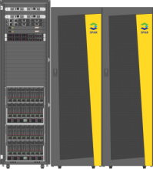

Seamless scalability, expanded flexibility
Single rack
Multi-rack
Configuration/Growth Options
Scale from 4 -16 blades
Scales across HP StoreServe 3PAR 7000 series storage options
HP Virtual Connect FlexFabric
HP Networking 5000 series switches
Direct-Attach FC support
Configuration/Growth Options
Scale from 4-64 blades across 2 compute racks
HP StoreServe 3PAR 7400 and 10000 storage option
HP Virtual Connect FlexFabric
HP Networking 5000 series switches
Protecting your investment as you grow
Notes:
HP Converged Systems RA for Red Hat on VirtualSystem VS3 builds on the VirtualSystem VS3 Foundation. HP VirtualSystem VS3 provides multiple design models, from single rack to multi-rack, for scalability and growth. Based on your individual requirements, you can choose from a broad number of flexible configurations and be assured that when the time is right to scale, that you’ll be able to do so seamlessly up to 64 blades and storage that is only limited by the capability of the largest 3PAR array.
Although the sizing options are extensive along a continuum, let me review a few specific configurations to give you an idea of how they could be deployed.

Slide 7
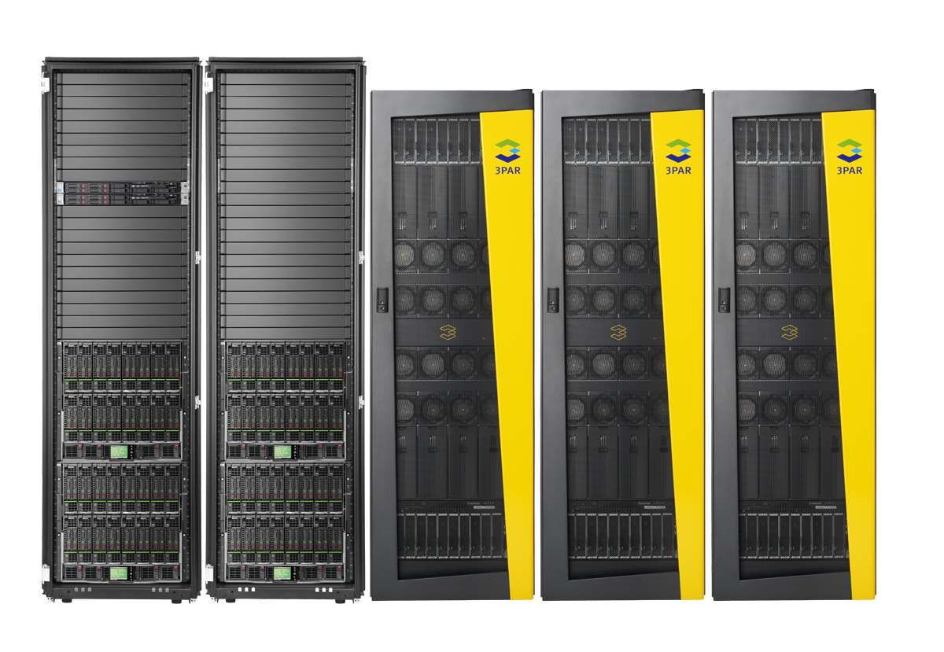
Best converged infrastructure for Red Hat
Power, connect, and store your way with highly optimized and integrated foundation
Best compute
70% more compute per watt
with HP BladeSystem
50% lower storage costs
guaranteed with HP 3PAR Storage
2x virtual machine density
Best storage
2.5x faster provisioning
5x faster network recovery time
with VirtualConnect and HP networking
Best interconnect
Notes:
As a result of those 10+ years of partnership that I spoke of earlier, we’ve gotten to know Red Hat well and today, HP delivers best-in-class HP Converged Infrastructure across the IT infrastructure for Red Hat environments, providing a highly optimized and integrated virtualization and cloud foundation.
Best compute
HP ProLiant Gen8 holds industry-leading benchmarks for servers running virtualization workloads from partners like Red Hat, and delivers 70% more compute capacity per watt, and accelerates server deployment and updates by 300% through its embedded management features
Best storage:
Reduce Storage Costs by 50% - Guaranteed. HP 3PAR StoreServ storage and software platforms support multiple levels of integration with Red Hat, providing a doubling of VM density to improve performance and scalability. In addition, since its introduction, 3PAR® Thin Provisioning software has become widely considered the gold standard in thin provisioning, helping customers minimize up-front capacity purchases by an average of 60% and meet Green IT targets. 3PAR Thin Provisioning and next-generation thin technologies also produce dramatic efficiency gains that cut SAN costs, floor space requirements, and energy expenses by up to 75% and decrease administration time by 90%.
Best cloud connect
With newer, more innovative switches, wireless devices, and security, HP FlexNetwork architecture dramatically increases performance and lowers latency, delivering up to 80% faster VM performance than standard networking architectures.
HP VirtualConnect now provides the industry’s first direct attach connection to Fiber channel storage not requiring dedicated Fiber Channel switches. This new capability in Virtual Connect FlexFabric modules increases the efficiency of server and storage connectivity by flattening the SAN Fabric. Designed for virtual and cloud workloads, this solution reduces storage networking costs by 50% and enables 2.5X faster provisioning compared to competitive offerings and enables savings of 50% on interconnects

Slide 8
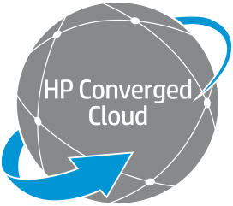




Red Hat technology solutions run best with HP
Joint expertise and unique innovations accelerate your journey to virtualization and the cloud
Private cloud
Managed cloud
Traditional
Public cloud
Red Hat virtualization and cloud run best on HP
Increased flexibility and simplicity
Optimized HP Converged Infrastructure for Red Hat virtualization and cloud
Included services for fast time-to-market and decreased risk
Reduce risk
Reliable, proven implementation best practices
Included services for fast time to market and decreased risk
Lower costs and greater investment protection
Open source software saves 60% to 80% over other solutions¹¹
Easily expandable infrastructure
Ready for the cloud
¹¹ redhat.com/resourcelibrary/datasheets/rhev-server-pricing-competitive
Notes:
As you’ve seen and heard today, HP and Red Hat have a broad range of solutions and services to help your organization accelerate your journey to virtualization and cloud. HP Converged Systems RA for Red Hat on VirtualSystem VS3 is a prime example of the innovations that result from years of customer experience and partnership investment.
I hope that you’ve learned a bit more about how we are working together to reduce complexity but at the same time, increase choice. Further, our innovations and engineering is delivering measureable efficiencies, resulting in lower costs for you. And finally, we believe that any investment that you make today has to payoff in the shortest time possible and be able to be leveraged in the longer term.

Slide 9

Take the next step
Accelerate your journey to virtualization and the cloud
Learn more about virtualization and private cloud solutions from HP and Red Hat:
hp.com/go/cloud
hp.com/go/redhat
hp.com/go/virtualsystem
Arrange for a technical evaluation, agility assessment, or infrastructure assessment
Investigate proof-of-concept testing
Get started with a virtualization or private cloud solution based on HP Converged Infrastructure and Red Hat.
Notes:
Contact your HP or HP partner sales representative today! Find out how you can accelerate your journey to virtualization and the cloud by working with HP and Red Hat.

Slide 10
Thank you

Slide 11
声明：
所有的版权属于原有公司，文件均来自公开渠道
此文件仅供学习使用，任何人不得进行以此为商业目的的行为
如有疑问，请立即删除
学习世界五百强和咨询公司PPT课程请访问如下网站搜索：“司马懿”
百度传课：司马懿PPT学校
网易学堂：司马懿PPT学校
知乎： 司马懿PPT学校
访问地址
https://www.chuanke.com
访问地址
https://study.163.com
访问地址
https://www.zhiu.com

